Slide 1
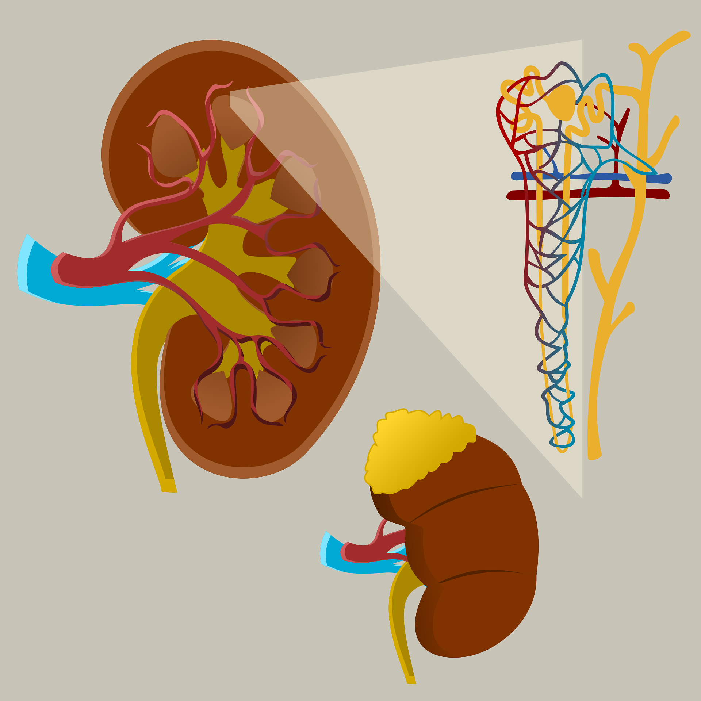
Readings and Graphic Organizers for Classroom Discussion
edMe Learning
Submitted to KidneyED Youth Innovation Challenge

Slide 2
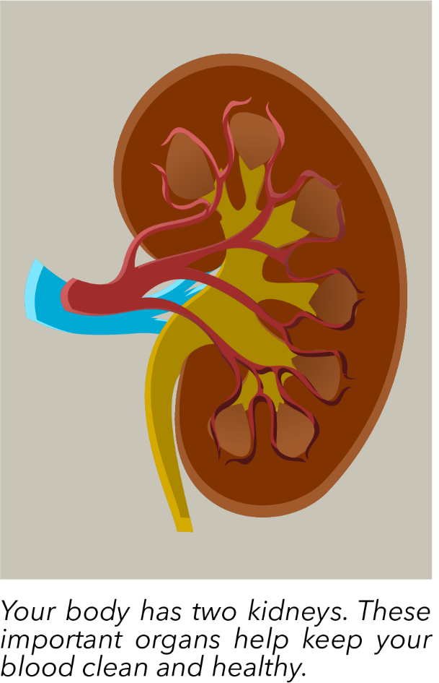
What is a Kidney, Anyway?
A kidney is a part of your body. It is an organ that looks like a big bean. You have two kidneys, and they are in your back, just below your ribs. They are very important, because they help keep your body clean and healthy.
The kidney’s main job is to clean your blood. Your blood carries food and oxygen to your body, but it also picks up waste. The kidney takes the waste out of your blood. This helps get rid of things your body does not need.
Kidneys also keep the right amount of water in your body. If you drink too much water, your kidneys help you remove the extra water. If you don’t drink enough, your kidneys save water to keep you from getting too thirsty. This balance is very important. It helps your whole body stay healthy!
edMe Learning’s Kidney Health Curriculum 2025
Slide 1 of 3

Slide 3
What is a Kidney, Anyway?
Doctors check on your kidneys. They know the kidneys could be sick when they hear issues about urination (peeing). People can feel uncomfortable talking about urination, but it is key information for doctors. They want to know if it is uncommon or a different color. These are important conversations between doctors and people with kidney issues.
Another thing kidneys do is help your body stay strong. They tell your bones to grow and help make red blood cells. Red blood cells carry oxygen, which gives you energy. Without your kidneys, your body would have a hard time working properly. Your kidneys make sure the rest of your body is strong.
In summary, kidneys are bean-shaped organs that clean your blood, balance water, and keep your body strong. They are like little cleaners and helpers inside you. Taking care of your kidneys helps your body stay healthy!
edMe Learning’s Kidney Health Curriculum 2025
Slide 2 of 3

Slide 4
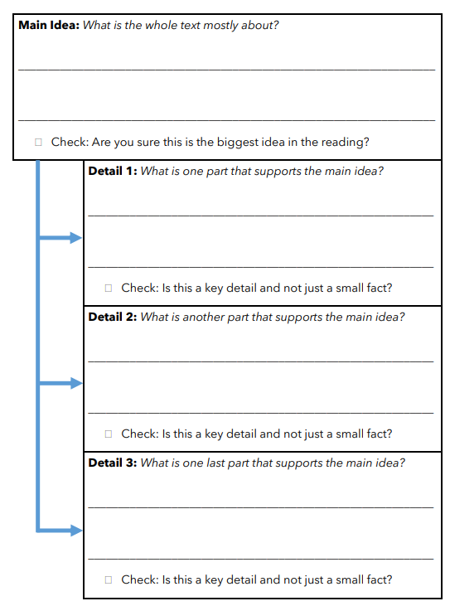
Graphic Organizer
First, describe the main idea.
Then, review your main idea.
Next, write the three key details.
Finally, review your details.
edMe Learning’s Kidney Health Curriculum 2025

Slide 5
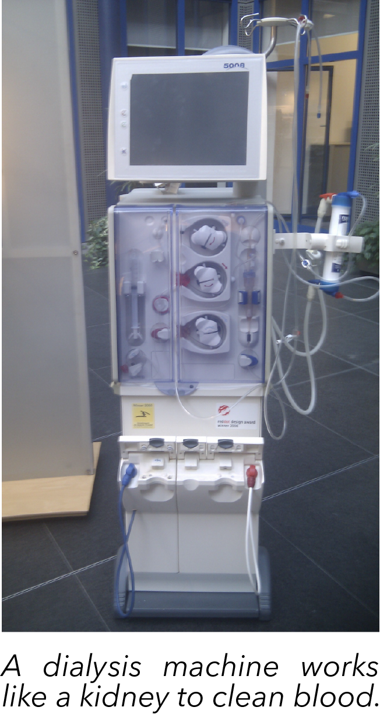
Kidneys Can Stop Working
Kidneys can stop working if they get hurt or sick. This is called kidney failure. Sometimes, a disease like diabetes or high blood pressure hurts the kidneys over time. Other times, an injury or infection can damage them quickly.
When kidneys fail, they can’t clean the blood. The waste and extra water stay in the body. This makes a person feel tired, sick, and swollen. Our bodies needs clean blood to work, so kidney failure is very serious.
edMe Learning’s Kidney Health Curriculum 2025
Slide 1 of 2

Slide 6
Kidneys Can Stop Working
Sometimes, kidneys fail because they don’t get enough blood. This can happen if someone is very sick or loses a lot of blood. Taking certain medicines for too long can also hurt the kidneys. It is important to be careful with your body and listen to your doctor to protect your kidneys.
If kidneys fail, doctors can help fix them. They can use a machine called a dialysis machine to clean the blood. This machine works like a kidney. Some people may also get a new kidney from a donor. Someone else gives them an extra kidney through surgery. These treatments help people stay alive and feel better.
In summary, kidneys fail when they get hurt or sick. When they fail, they can’t clean any more blood. This makes the rest of the body sick. But, doctors can help fix kidney failure with machines or surgery. Taking care of your health protects your kidneys and keeps them working well.
edMe Learning’s Kidney Health Curriculum 2025
Slide 2 of 2

Slide 7
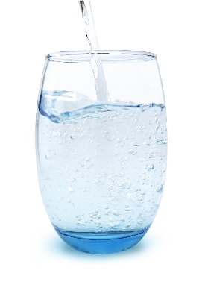
Keep Your Kidneys Healthy
People take care of their kidneys by listening to their doctors and living a healthy lifestyle. A key part of staying healthy is drinking some water every day. Healthy foods, like fruits and vegetables, are also important. Exercise also ensures your kidneys are strong. All of these strategies help care for your kidneys.
Your kidneys stay healthy when you drink water every day. Water helps your kidneys clean your blood and get rid of waste. When you drink enough water, your kidneys can work well. People should drink mostly water instead of sugary drinks like soda. A doctor or nurse can help you decide how much water is the right amount. Your body needs different amounts of water as you grow.
edMe Learning’s Kidney Health Curriculum 2025
Slide 1 of 3

Slide 8
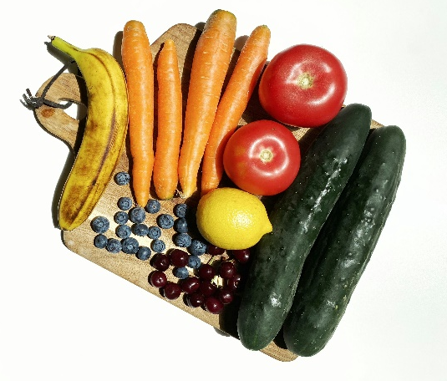
Keep Your Kidneys Healthy
Eating healthy foods also keeps your kidneys strong. Foods like fruits, vegetables, and whole grains are good for your body. People should avoid too much salty food, like chips, or sugary snacks, like candy. If you aren’t sure what foods can help your body, ask a doctor or nurse questions about your diet. Healthy food helps your kidneys and your whole body work better.
Playing and moving your body helps your kidneys too. Exercise like running, jumping, and walking keeps your blood flowing and your body strong. It also helps keep your weight healthy, which is good for your kidneys. Find fun ways to stay active every day!
In summary, drinking water, eating healthy, staying active, and following your doctor’s advice keep your kidneys healthy. When you take care of your kidneys, they take care of you by keeping your body clean and strong.
edMe Learning’s Kidney Health Curriculum 2025
Slide 2 of 3

Slide 9
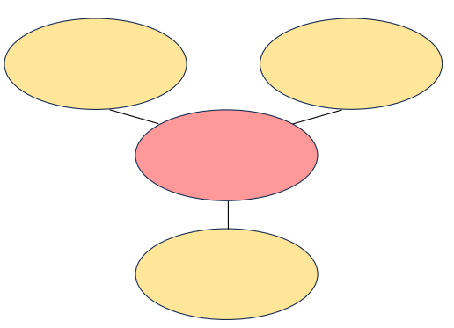
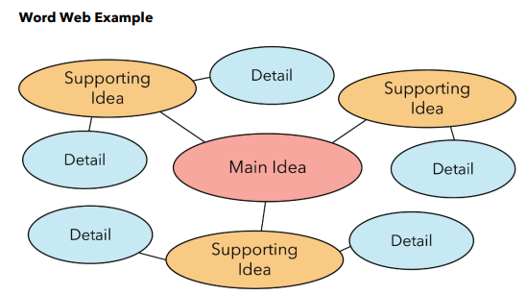
Graphic Organizer
edMe Learning’s Kidney Health Curriculum 2025
Slide 3 of 3

Slide 10
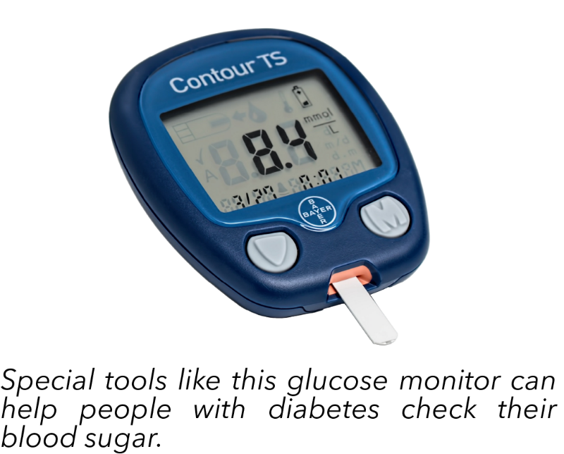
Diabetes Can Cause Kidney Problems
Diabetes is a type of illness. Diabetes happens when your body has trouble using sugar for energy. Your body uses a chemical called insulin to help sugar from food get into your cells. If your body doesn’t make enough insulin or does not use it well, sugar stays in your blood instead of helping your body. This is called diabetes.
Diabetes can be caused by different things. It could happen if someone eats too much sugary food and doesn’t exercise enough. Sometimes, it runs in families, meaning you can get it because your parents or grandparents pass it through their genes. This illness mostly happens as people get older but many students have diabetes, too.
edMe Learning’s Kidney Health Curriculum 2025
Slide 1 of 3

Slide 11
Diabetes Can Cause Kidney Problems
Diabetes can hurt your kidneys, eyes, and nerves. It can make your kidneys work too hard to clean extra sugar in the blood. Over time, this can make the kidneys stop working. It can also hurt your eyes by damaging tiny blood vessels, which can make it hard to see. Diabetes can hurt your nerves by damaging these tiny wires that carry messages in your body. This can cause pain, tingling, or numbness, especially in your hands and feet.
There are ways to improve diabetes. People who have diabetes get help from their doctors so they can keep living healthy lives. They monitor their blood sugar levels. Eating healthy meals and exercising can help your body manage diabetes. Medicines and insulin treatments can also help.
In summary, diabetes happens when your body has trouble using insulin. It affects the sugar in your blood. Kidney failure is one effect of diabetes. Other parts of your body can also be affected by diabetes. Keeping blood sugar at a safe level helps prevent diabetes and keep your body healthy.
edMe Learning’s Kidney Health Curriculum 2025
Slide 2 of 3

Slide 12
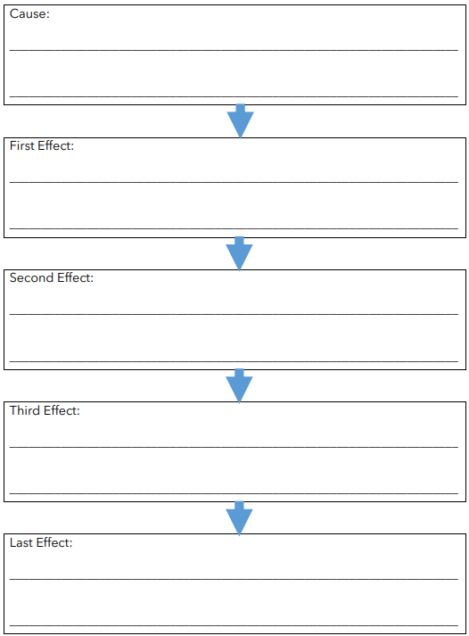
Graphic Organizer
State the first cause.
Complete the chains of causes and effects described in the text.
edMe Learning’s Kidney Health Curriculum 2025
Slide 3 of 3

Slide 13
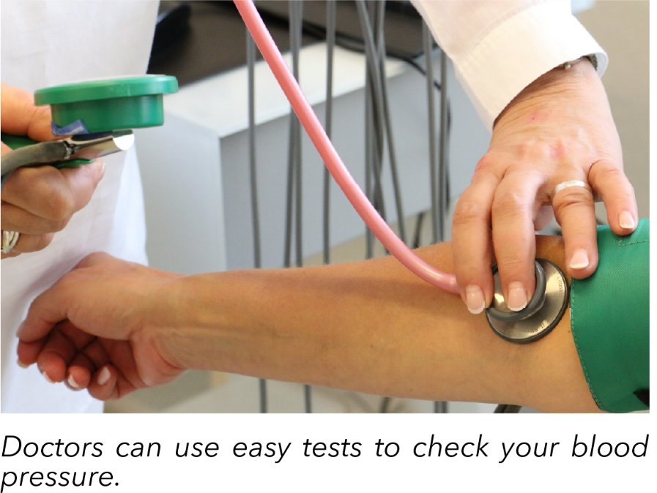
High Blood Pressure Can Cause Problems
Blood moves through every part of your body. It carries important things throughout your body, like oxygen and nutrients. Your heart beats to move blood around your body. Problems with your blood can cause problems in other parts of your body. High blood pressure is one problem that can be harmful.
Your blood moves through tiny tubes called blood vessels. High blood pressure happens when your blood pushes too hard on the walls of your blood vessels. Your heart pumps blood through blood vessels called veins and arteries. If your arteries get too tight or your heart has to work too hard, the pressure goes up. This can hurt your heart and other parts of your body.
edMe Learning’s Kidney Health Curriculum 2025
Slide 1 of 3

Slide 14
High Blood Pressure Can Cause Problems
High blood pressure can hurt your kidneys. One day of high blood pressure won’t hurt you. But, it can have serious consequences over time. If you have high blood pressure for a long time, the blood vessels around your kidneys may get weak or damaged. This makes it difficult for your kidneys to filter blood and keep it clean. It can also lead to more high blood pressure in the future.
Doctors can help lower blood pressure if it is too high. Some medicines help your heart and blood vessels, so the pressure is lower. Doctors can also teach people about lifestyle changes that help lower blood pressure. Eating healthy foods and exercising can help keep your heart strong. Lowering your stress can also help improve your blood pressure.
In conclusion, high blood pressure happens when your blood pushes too hard in your arteries. This can cause problems for your heart and kidneys. Eating healthy, staying active, and listening to doctors can help lower blood pressure to keep your body safe and strong.
edMe Learning’s Kidney Health Curriculum 2025
Slide 2 of 3

Slide 15
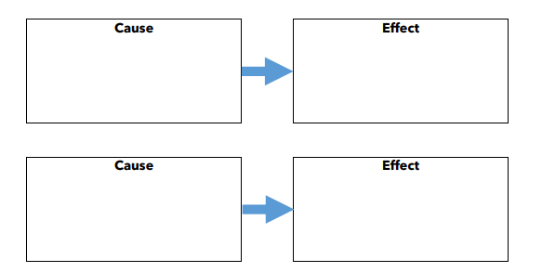
Graphic Organizer
edMe Learning’s Kidney Health Curriculum 2025
Slide 3 of 3

Slide 16
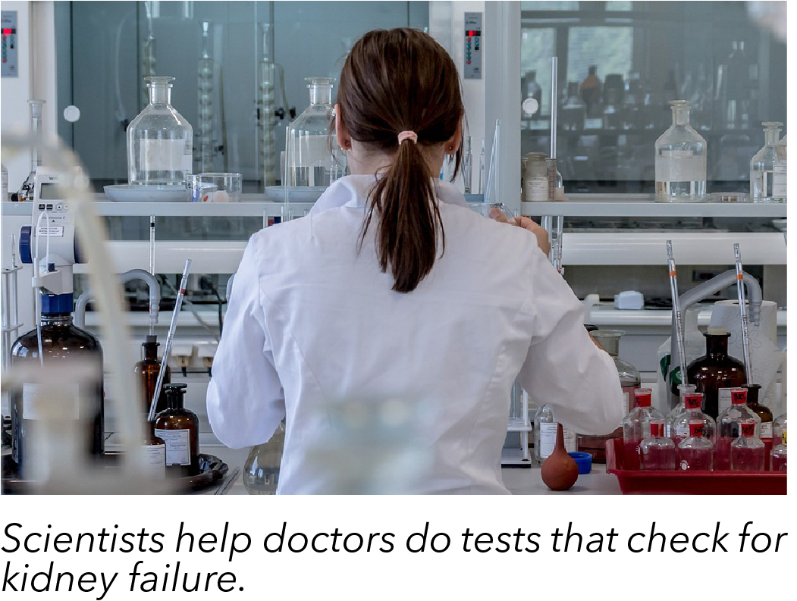
How Nurses Diagnose Kidney Failure
To diagnose kidney failure, first look for symptoms. Common symptoms include swelling in the legs, feet, or face, tiredness, and trouble urinating. Some people might also feel confused or have nausea. If nausea is an issue, keep the patient by a bathroom so vomit can be disposed of quickly. These symptoms show that the kidneys may not be working well.
When seeing a patient, check their medical history. While you read their chart, ask about illnesses like diabetes or high blood pressure. These can hurt the kidneys over time.) Also, ask about any medicines the patient takes because some drugs can damage the kidneys. Seeing a person’s past medical needs can help understand what might be happening now.
edMe Learning’s Kidney Health Curriculum 2025
Slide 1 of 2

Slide 17
How Nurses Diagnose Kidney Failure
There are three tests that check kidney function. A blood test measures creatinine levels, which rise when kidneys are not working. Creatinine is a chemical sign that the kidneys are failing. Another test, called a GFR (glomerular filtration rate), shows how well the kidneys filter waste. A urine test checks for protein or blood, which are signs of kidney damage.
You can also check for physical changes. Swelling, high blood pressure, and changes in weight can point to kidney failure. If you are still in doubt, collaborate with other medical experts. More tests, like an ultrasound, may be needed to look at the kidneys directly.
In summary, nurses diagnose kidney failure by looking for symptoms, reviewing medical history, and performing tests. You can check for changes in the body and use test results to find out how well the kidneys work. Quick diagnosis helps patients get the care they need. Keep an eye out for kidney failure!
edMe Learning’s Kidney Health Curriculum 2025
Slide 2 of 2

Slide 18
Jigsaw: Working Together on Four Readings
1. Kidneys Work with Other Organs
Why do the kidneys need the heart?
What is another organ kidneys work with? How do they work together?
Are the kidneys important compared to these other organs?
2. The Small Parts of Your Kidney that Make a Big Impact
What are the key parts of the nephron?
What are the two parts of the nephron and how do they work together?
How is waste removed in this process?
3. Chemicals that Work in Your Kidneys
What does it mean that your kidneys regulate the amount of chemicals?
What is the purpose of ADH?
What is glucose? / d. How is glucose related to your kidneys?
4. The Path Through the Kidneys
Where does the flow of blood start? Where does it end?
How would you describe how the blood passes into the filters and back into the bloodstream?
Where does the waste flow out of the kidney?
edMe Learning’s Kidney Health Curriculum 2025

Slide 19
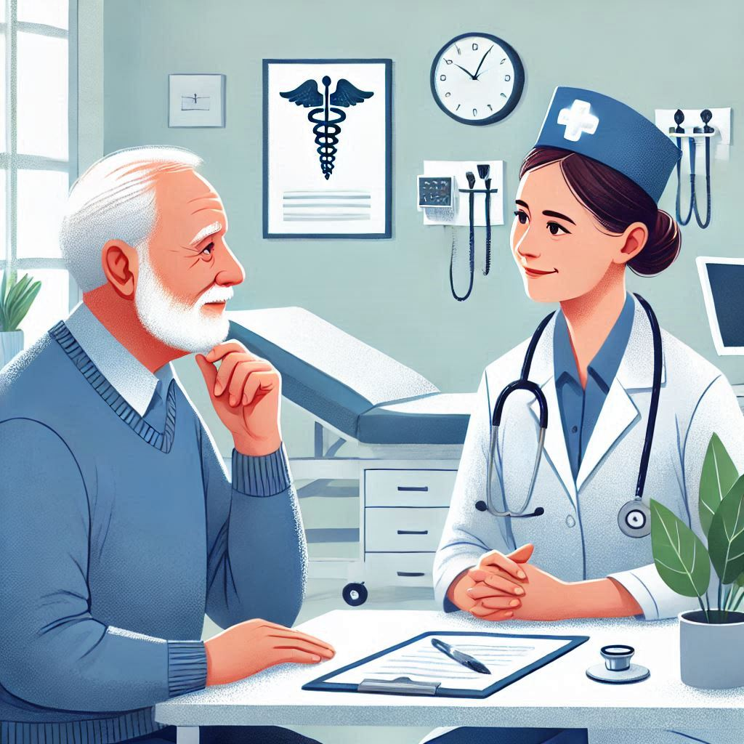
The Story: A Visit to the Clinic
Nurse: Good morning, Mr. Turner. What brings you in today?
Mr. Turner: Good morning. I’ve been feeling really tired lately, and my feet are so swollen I can barely get my shoes on.
Nurse: I see. Swelling can be a sign of a few things. Have you noticed anything else?
Mr. Turner: Well, I feel nauseous sometimes. I thought it was just stress, but now I think it means something more. I also use the bathroom less often than I did.
Nurse: Let’s start by going over your medical history. Do you have any health conditions like diabetes or high blood pressure?
Mr. Turner: Yes, I’ve had diabetes for about ten years. I didn’t take it too seriously at first, and honestly, I still struggle to control my sugar levels.
Nurse: Diabetes can put a strain on your kidneys. Have you been eating a lot of sugary or salty foods recently?
Mr. Turner: I’ve always had a sweet tooth. When I was a kid, I ate candy every day, and even now, I have dessert almost every night. I know it’s not great for me, but I didn’t think it could do this.
edMe Learning’s Kidney Health Curriculum 2025
Slide 1 of 5

Slide 20
Nurse: Eating a lot of sugar over time can contribute to diabetes and kidney problems. When did the swelling and tiredness start?
Mr. Turner: A few weeks ago. At first, I thought it was just from standing too much, but now it’s not going away.
Nurse: Swelling and less urination can mean your kidneys aren’t working well. I’d like to do some tests to check how your kidneys are functioning.
Mr. Turner: Okay. Is it serious?
Nurse: We’ll know more after the tests. I’m going to draw some blood to measure your creatinine level, which tells us how well your kidneys are filtering waste.
[Time passes, then the nurse returns with the test results.]
Nurse: Mr. Turner, your creatinine level is quite high. This means your kidneys are not filtering waste as they should. Combined with your symptoms, it looks like your kidneys are not working properly.
Mr. Turner: Does this mean I have kidney troubles?
Nurse: Yes, it seems like your kidneys are failing. The diabetes and high sugar intake over time likely contributed to this. We’ll need to refer you to a specialist to discuss treatment options, like medication, dialysis, or other care to manage this.
Mr. Turner: I see. I wish I’d been more careful earlier, but I’m ready to do whatever it takes now.
Nurse: That’s a good step, Mr. Turner. We’ll work together to help you feel better and take care of your kidneys as best as we can.
edMe Learning’s Kidney Health Curriculum 2025
Slide 2 of 5

Slide 21
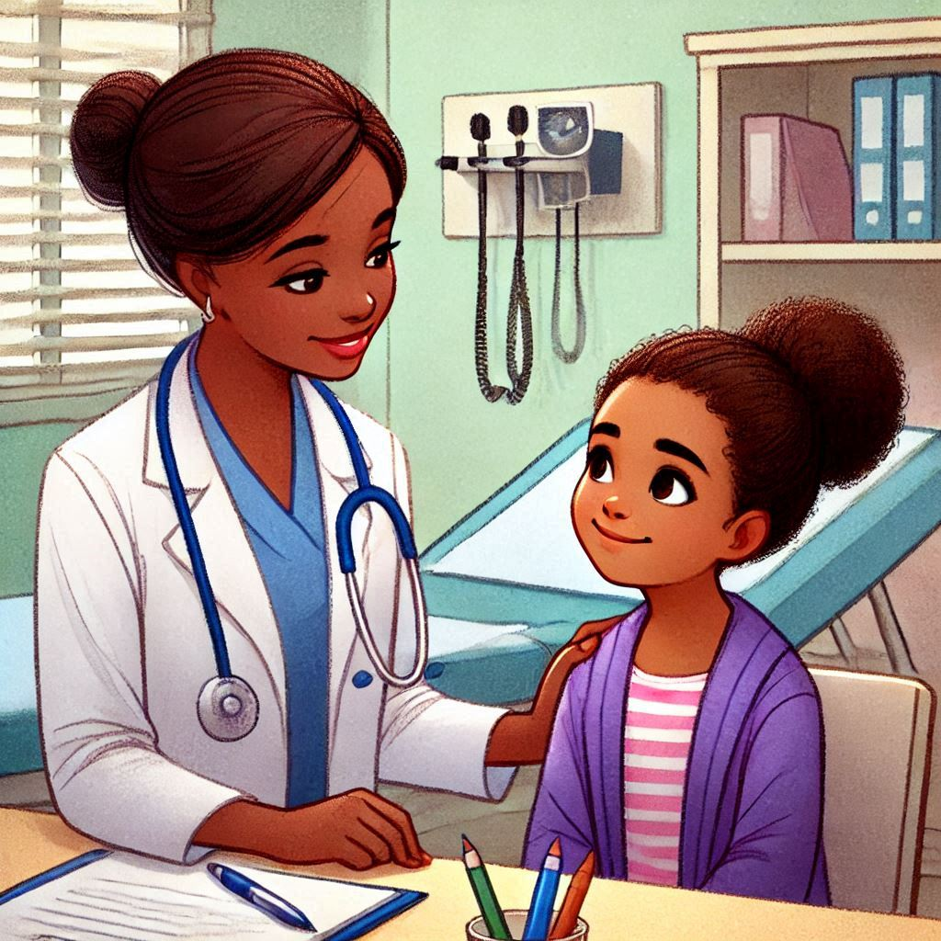
The Story: A Candy Problem
Nurse: Hi there, Emma. I’m Nurse Lisa. What brings you to the clinic today?
Emma: Hi. My stomach hurts a lot, and I feel like I might throw up.
Nurse: I’m sorry you’re feeling that way. When did it start?
Emma: This morning. It got worse after lunch.
Nurse: Hmm. Did you eat anything unusual or a lot of something yesterday?
Emma: Well… I had a lot of candy yesterday. It was my friend’s birthday, and we had a big bag of chocolates and gummy bears.
Nurse: That’s helpful to know. Sometimes eating too much candy can upset your stomach. I just want to ask a few more questions to be sure. Do you have any swelling in your feet, legs, or face?
Emma: No, I don’t think so.
Nurse: Have you been going to the bathroom normally?
Emma: Yeah, everything seems the same.
edMe Learning’s Kidney Health Curriculum 2025
Slide 3 of 5

Slide 22
Nurse: Good. Do you have diabetes or any other health problems?
Emma: No, my mom says I’m healthy.
Nurse: That’s great to hear. I’m going to check a few things to make sure your kidneys are okay since eating a lot of sugar every day can sometimes lead to problems. I’ll take a little blood to check your creatinine level. It’s a quick test, and I’ll explain the results when I’m back.
[Time passes, then the nurse returns with the results.]
Nurse: Good news, Emma! Your creatinine level is completely normal. Your kidneys are working just fine. It seems like your stomach ache is just from eating too much candy in one day.
Emma: Oh, phew! So it’s not serious?
Nurse: No, it’s not serious, but it’s a good reminder to eat candy in moderation. Too much can upset your stomach and isn’t great for your health. Try to enjoy sweets in smaller amounts next time, okay?
Emma: Okay, I’ll be more careful. Thank you, Nurse Lisa.
Nurse: You’re welcome, Emma. Drink some water and eat something healthy today, and you should feel better soon!
edMe Learning’s Kidney Health Curriculum 2025
Slide 4 of 5

Slide 23
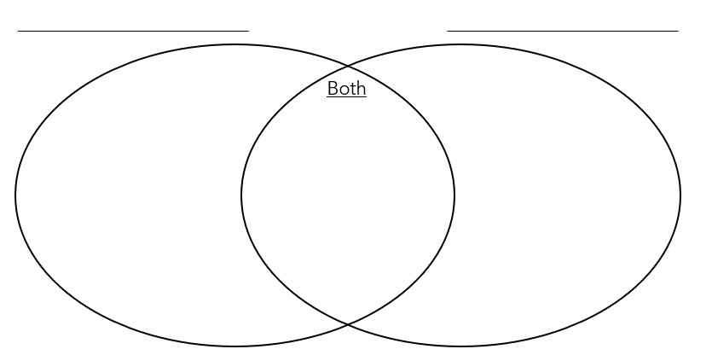
Graphic Organizer
edMe Learning’s Kidney Health Curriculum 2025
Slide 5 of 5

Slide 24
Living with Kidney Disease
Maria lives with chronic kidney disease. She had high blood pressure for many years after her grandson was born. She didn’t feel very sick, but she was tired and sometimes didn’t want to eat any of her favorite food anymore. She thought her high blood pressure may be causing other problems.
Then, she went to her doctor for a normal checkup. Her doctor did some blood tests and found out that Maria’s kidneys were working too hard. They were damaged. She would need to take extra care of her kidneys for the rest of her life. So, Maria was diagnosed with chronic kidney disease.
This text is a page from Maria’s diary.
edMe Learning’s Kidney Health Curriculum 2025
Slide 1 of 3

Slide 25
Living with Kidney Disease
Today was a great day! When I woke up, there weren’t any clouds in the sky. I took my blood pressure medicine when I ate a tasty breakfast. I cooked some eggs and toast, since Dr. Kelly said they were good for me. I drank my water in the pretty cup that Leo gave me for my birthday. It says, “World’s Best Grandma”!
After breakfast, I decided to invite Leo over for the afternoon. He didn’t have school, so I thought we could spend some time together. I made sure there were a few healthy snacks at home in case we got hungry. I bought some fresh fruit at the store yesterday, too.
Dr. Kelly said I should get plenty of fresh air and exercise, so Leo and I went for a walk. We got to enjoy the warm summer weather. We even saw some butterflies in the backyard!
I’m so glad Dr. Kelly is helping me care for my kidneys. I remember last year before we found my chronic kidney disease, I was so tired. I think I would have been too tired to play with Leo. I remember how valuable my health is every time I get to have a good day like today. I hope Leo grows up healthy, too!
edMe Learning’s Kidney Health Curriculum 2025
Slide 2 of 3

Slide 26
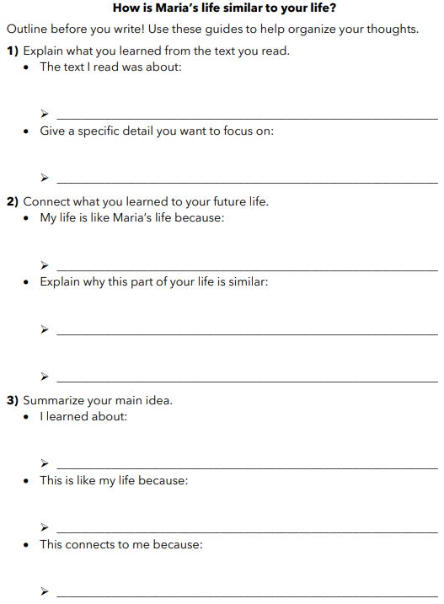
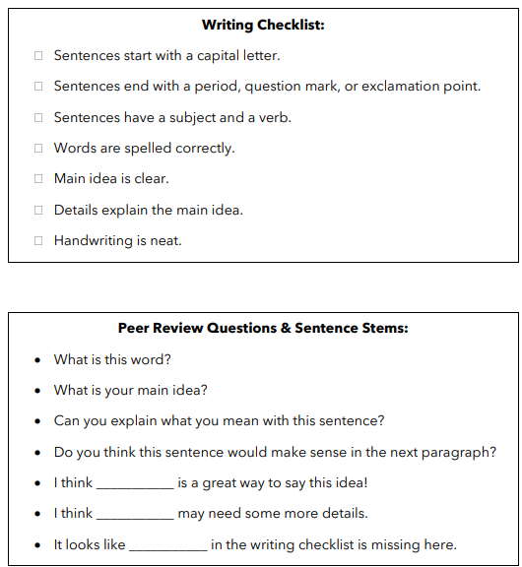
Graphic Organizer & Rubric
edMe Learning’s Kidney Health Curriculum 2025
Slide 3 of 3

